Slide 1
The first Hub for Developers
SQL Databases
Charalampos Karypidis
Code.Learn:
.Net Academy

Slide 2

Agenda
Introduction to data access
Using ADO.NET to access data
Object Relational Mapper (ORM)
Entity Framework
Language Integrated Query (LINQ)

Slide 3
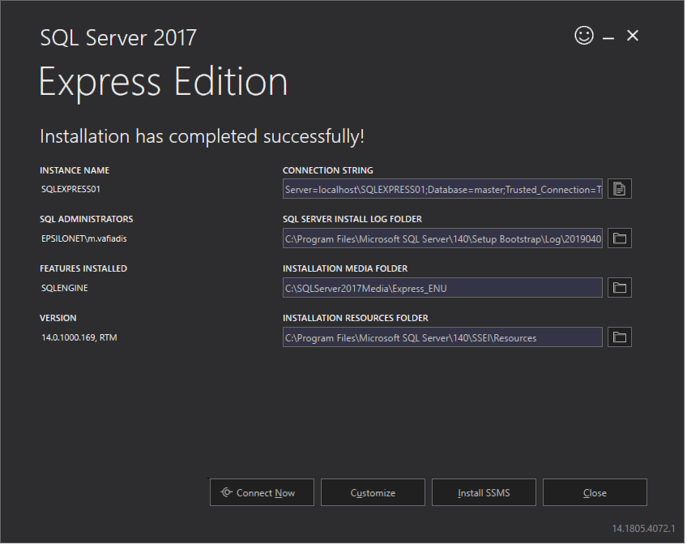

Prerequisites
Download / Install:
>> Microsoft SQL Server 2017 - Express Edition
Basic Installation (unless you already have other versions / instances)
Note: Version 14.0 refers to 2017
>> Microsoft SQL Server Management Studio
(SSMS)
https://www.microsoft.com/en-us/sql-server/sql-server-editions-express
Prerequisites

Slide 4
All applications require some form of permanent state store
User interacts with the application
Application processes user commands
Permanent store saves the outcome
Accessing data

Slide 5
Accessing data through ADO.NET
What is ADO.NET?
An object oriented set of classes that allows you to interact with database systems
Database
Our Program
ADO.NET
ADO.NET
Notes:
After this slide we change to VS to demonstrate the usage of ADO.NET

Slide 6
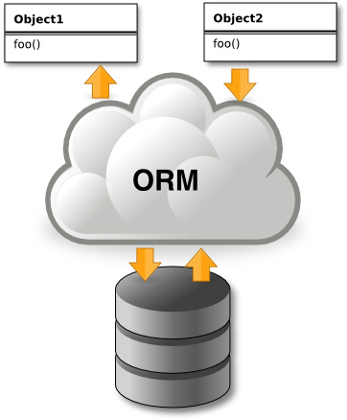
Object Relational Mapping
Object-Relational Mapping (ORM) is a programming technique for automatic mapping data and database schema
Map relational DB tables to classes and objects
ORM creates a "virtual object database"
Used from the programming language (C#, Java, PHP, …)
ORM frameworks automate the ORM process
A.k.a. Object-Relational Persistence Frameworks
ORM
Notes:
Object-relational mapping is a technique that enables developers to work with data in object-oriented way by performing the work required to map between objects defined in an application's programming language and data stored in relational datasources
Save time, less code, strong type
See below
An entity is a class that (in basic operations) maps to a single database table
How we define related data between tables
Represents a session with a database
Set of entity classes and a context
Instances of your entity classes are retrieved from the database using Language Integrated Query
Data is created, deleted, and modified in the database using instances of your entity classes.

Slide 7
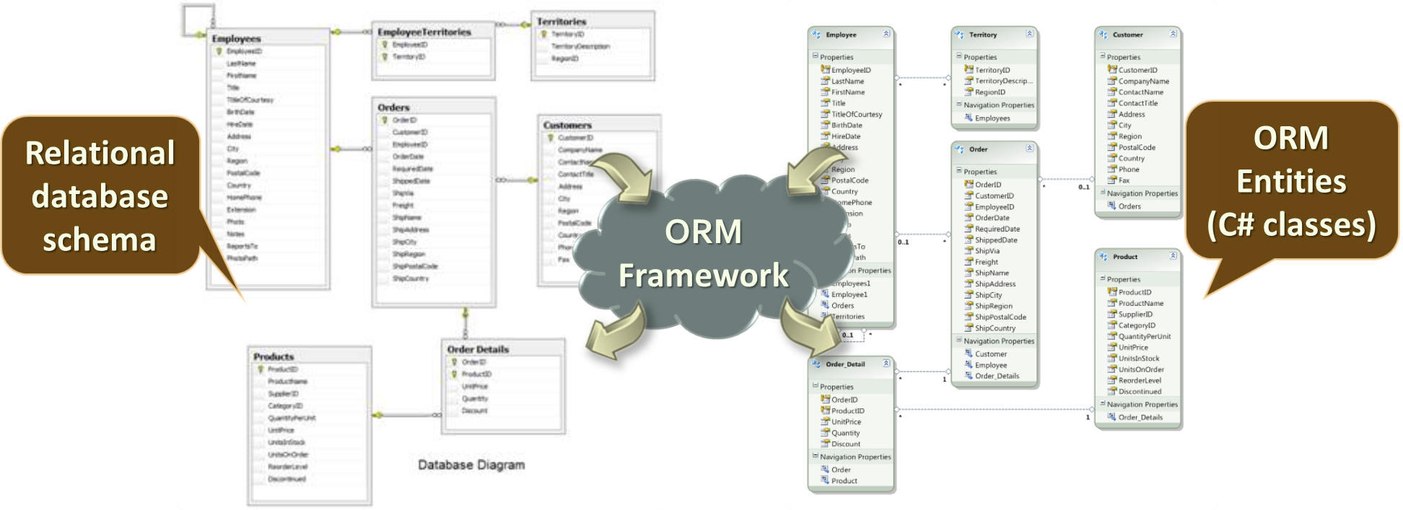
ORM Mapping - Example
ORM

Slide 8
Overview of EF
Entity Framework (EF) is the standard ORM framework for .NET
Maps relational database to C# object model
Powerful data manipulation API over the mapped schema
CRUD operations and complex querying with LINQ
Database first approach: from database to C# classes
Code first approach: from classes to DB schema
Visual Studio generates EF data models
Data mappings consist of C# classes
Entity Framework

Slide 9
EF building blocks
DbContext
DbSet
Model
Relationships
Entity Framework

Slide 10
DbContext
Handles connections
Change Tracking
Model Building
Data Mapping
Basic operations
Add data
Modify Data
Delete Data
Entity Framework

Slide 11
DbSet
Represents a collection for a given entity within the model
Gateway to database operation against an entity
Default mapped to table (using the name of entity as the table name)
Basic operations
Querying data
Add data
Modify Data
Delete Data
Entity Framework

Slide 12
Model
Conceptual model of an application domain
Expressed as a set of classes (entities)
Conventions
Primary Key
Foreign Key
Table
Schema
Columns
Configuration
Fluent API
Attributes
Entity Framework

Slide 13
Relationships
Defined by navigation properties
Types of relationships
One to One
One to Many
Many to Many
Entity Framework

Slide 14
Language Integrated Query
Adds the ability to query any collection of objects
We can query
Objects in memory, e.g. collections (LINQ to Objects)
Databases (LINQ to Entities)
XML (LINQ to XML)
ADO.NET Data Sets (LINQ to Datasets)
LINQ

Slide 15
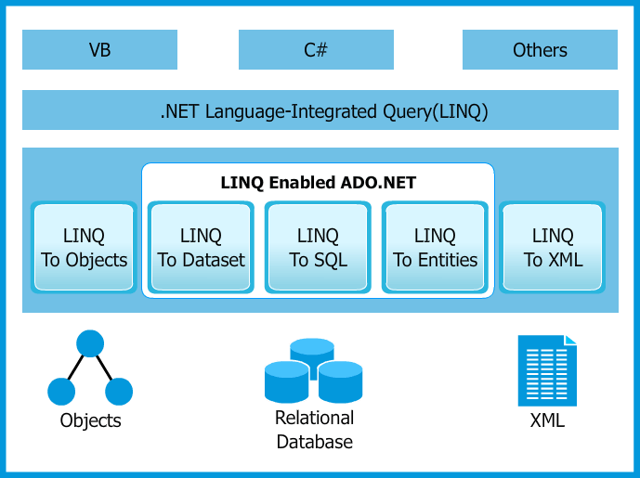
LINQ Architecture
LINQ

Slide 16
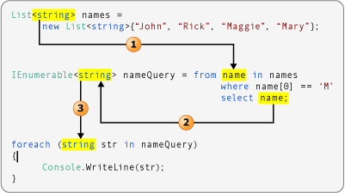
LINQ Sample
LINQ

